Slide 1
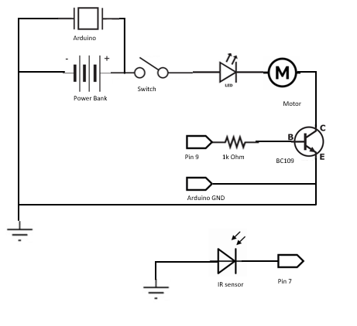
Inail pro schematic diagram

Slide 2
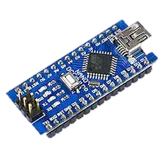
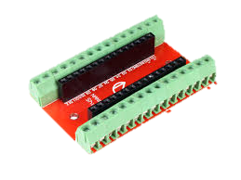
Connect the Arduino Nano to Arduino Nano Shield
Arduino Nano
Arduino Nano Shield

Slide 3
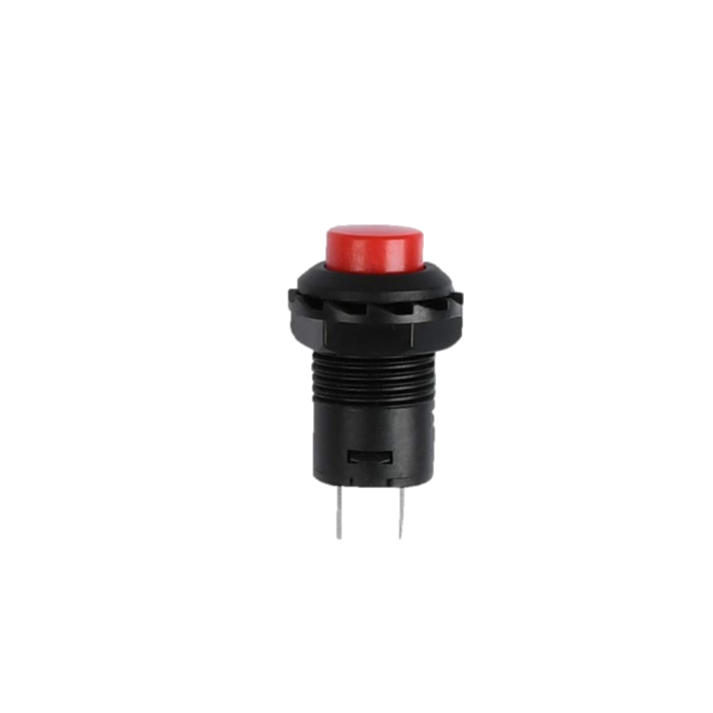

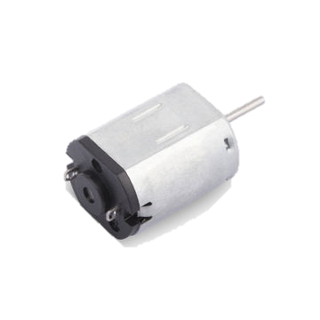
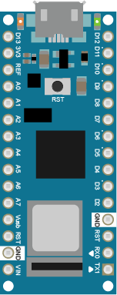
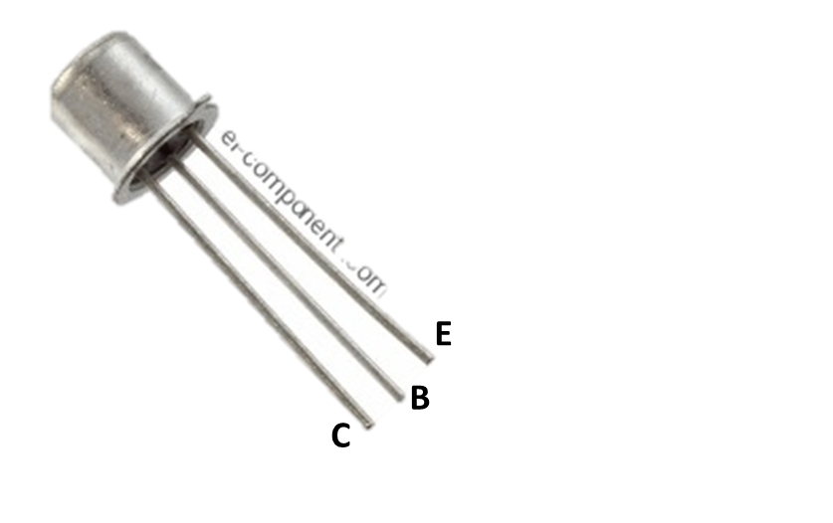
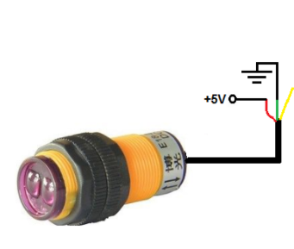
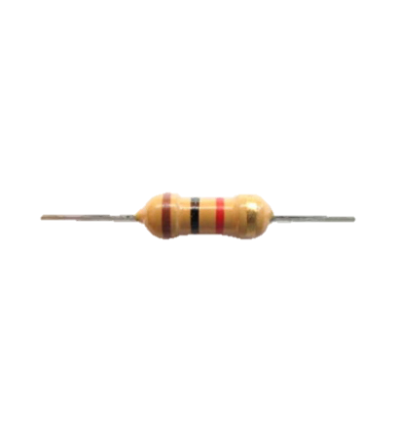

Slide 4
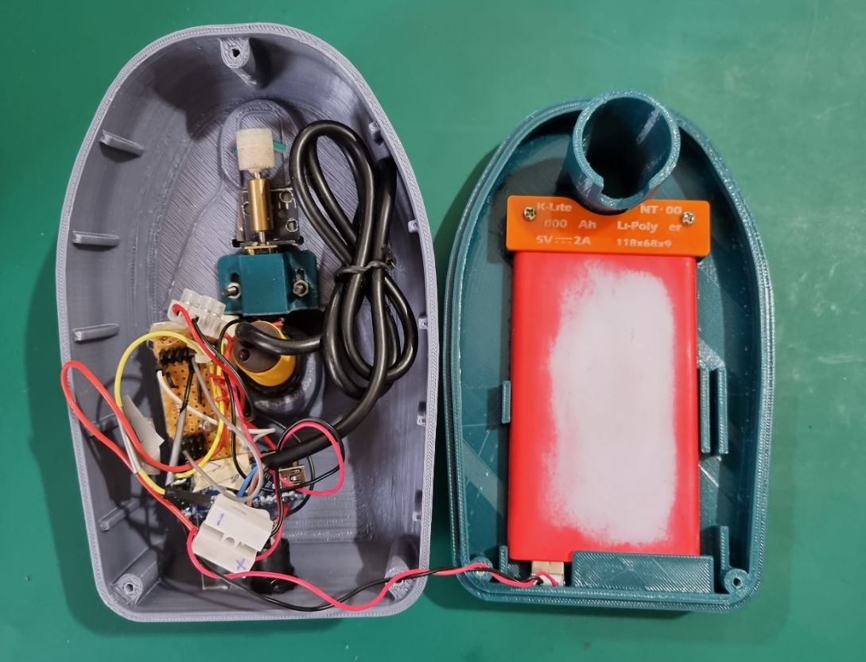
Fix the grinding stone onto the mini motor.
Fix the mini motor onto iNail Pro Cover with the mini motor mount (M4 Screws are used to secure the mini motor mount).
3) Secure the proximity sensor onto the iNail Pro Cover
4) Secure the On/Off Button onto the iNail Pro Cover
5) Secure the powerbank onto the iNail Pro Base

